Slide 1
Realistic Image Synthesis With Cascaded Refinement Networks
Cs60 Xiang zhang

Slide 2
Realistic Image Synthesis
Image synthesis is the process of creating new images from some form of image description.
Realistic image synthesis is the process of creating images that are, in some way, accurate representations of a real scene. Often, the images are meant to be viewed by a human observer
My project is based on the paper:
Photographic Image Synthesis with Cascaded Refinement Networks, ICCV,2017

Slide 3
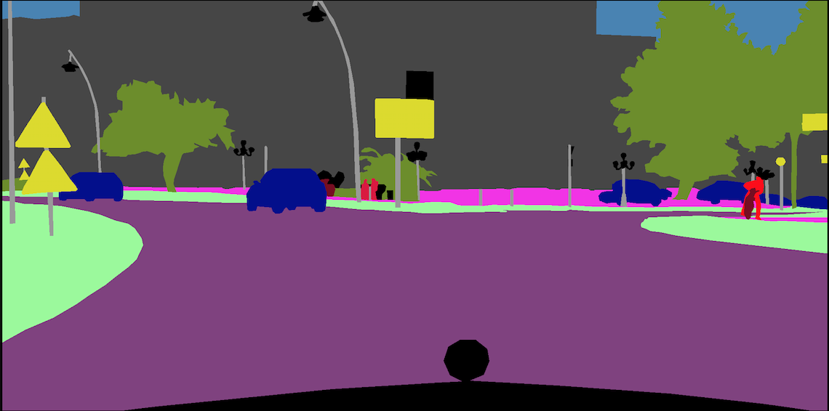
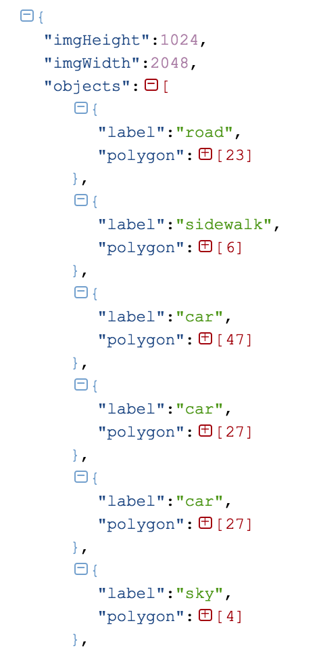
Cityscapes dataset
Consider a semantic layout L ∈ {0,1}^{m×n×c}, where m×n is the pixel resolution and c is the number of semantic classes. Each pixel in L :one-hot vector indicates its semantic label
L(i, j)∈ {0,1}^{c}
Our goal is to train a parametric mapping g that given a semantic layout L produces a color image I∈R^{m×n×3} that conforms to L.

Slide 4
Cascaded Refinement Networks
The Cascaded Refinement Network (CRN) is a cascade of refinement modules. Each module Mi operates at a given resolution. In my implementation, the resolution of the first module (M0) is 4 x 8. And then doubled it until modules Mi. (256 x 512: i = 6; 512 x 1024: i = 7)
The first module,M₀, receives the semantic layout L as input (downsampled to w₀×h₀) and produces a feature layer F₀ at resolution w₀×h₀ as output.
Photographic Image Synthesis with Cascaded Refinement Networks, ICCV, 2017

Slide 5
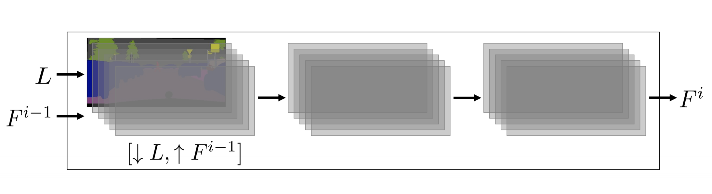
Cascaded Refinement Networks
The other modules Mi(for i̸= 0) :Mi receives a concatenation of the layout L(downsampled to wi×hi) and the feature layer F_{i−1}(upsampled to wi×hi) as input, and produces feature layer Fi as output
Each module Mi consists of three feature layers:
the in-put layer, an intermediate layer, and the output layer. Each layer is followed by 3×3 convolutions, layer normalization , and LReLU nonlinearity .
Hinton. Layer normalization.arXiv:1607.06450, 2016.
Rectifier nonlin-earities improve neural network acoustic models. InICML,2013

Slide 6
Cascaded Refinement Networks
The output layer F̄i of the final module Mi is not followed by normalization or nonlinearity. Instead, I use a linear projection (1×1convolution) to map the final layer F̄i to the output color image (dimensionality wi×hi×3).

Slide 7
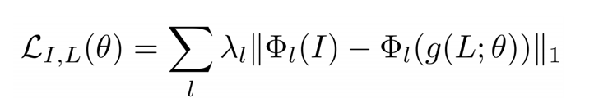
Loss Function
The CRN is trained in a supervised fashion on a semantic segmentation dataset D={(I,L)}. A semantic layout L is used as input and the corresponding color image I as output. Given the under constrained nature of the problem, using an appropriate loss function is critical
L is used as input layout and the corresponding color image I as output.
Φ is a trained visual perception network (VGG-19).
g is the image synthesis network being trained and θ is the set of parameters of this network. The hyper parameters {λ_{l}} balance the contribution of each layer l to the loss.
Assume loss tend to 0, we found the Φ_{l}(I)−Φ_{l}(g(L;θ)) = 0, I = g(L, θ)

Slide 8
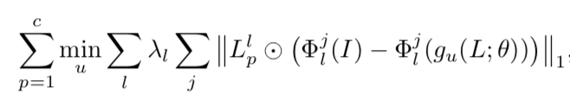
Synthesizing A Diverse Collection
Since a given semantic layout can correspond to many images, it also makes sense to generate a diverse set of images as output
So, if we change the loss function
For each semantic class p, let L_{p} denote the corresponding channel L(·,·, p) in the input label map, and ⊙ is the Hadamard product.
This loss takes the best synthesized content for each semantic class from the whole collection

Slide 9
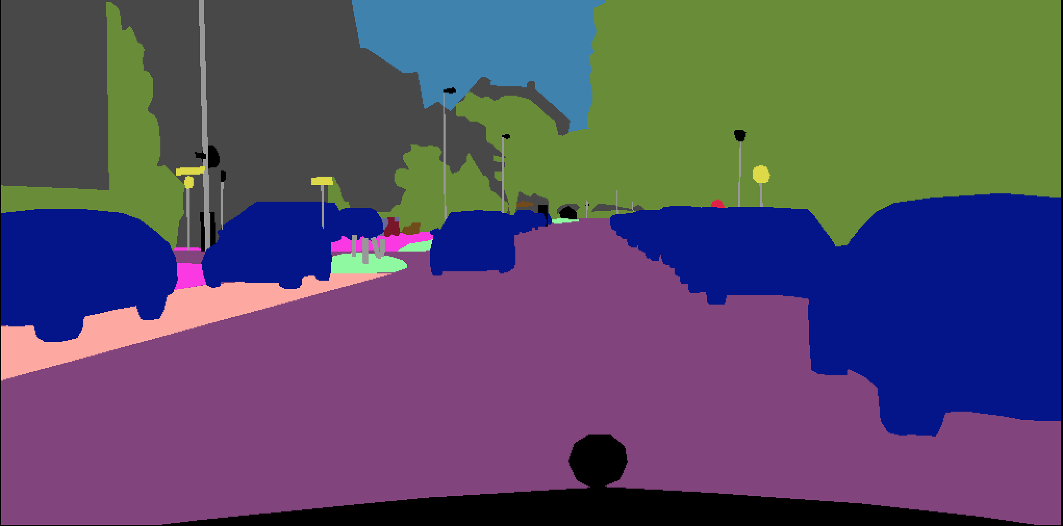
Result
input

Slide 10
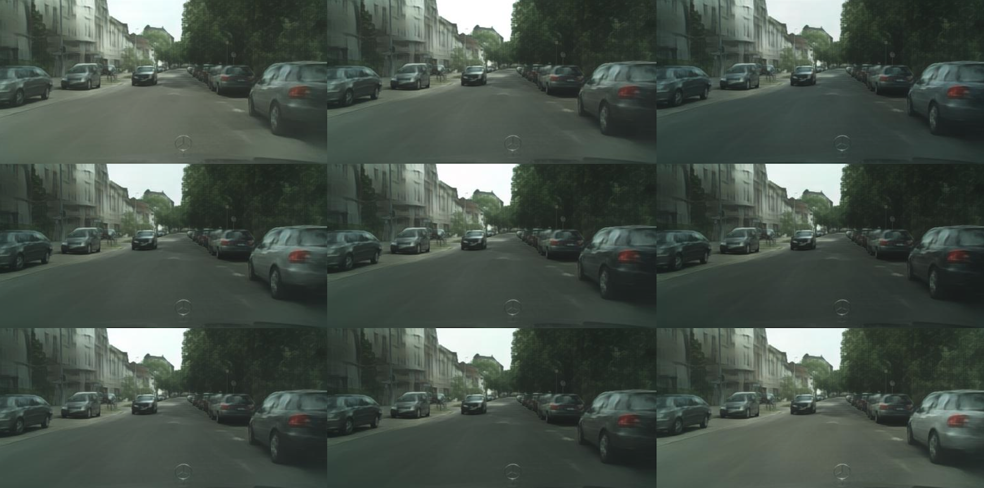
Result
256 x 512

Slide 11
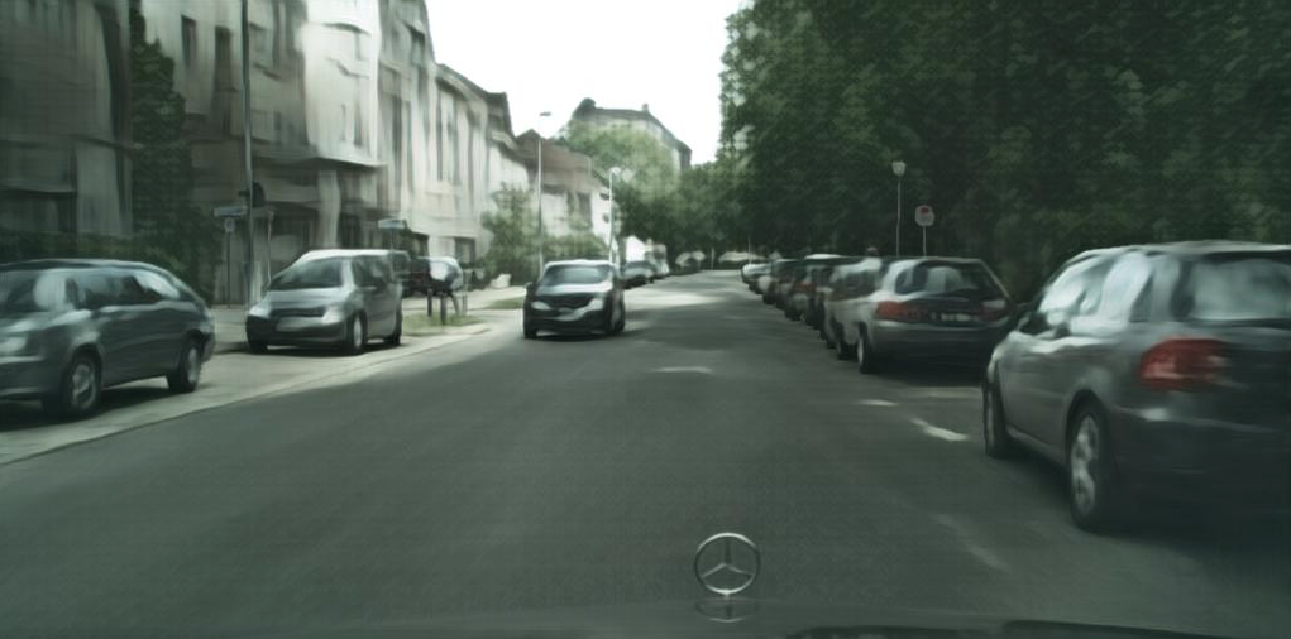
Result
512*1024

